Slide 2
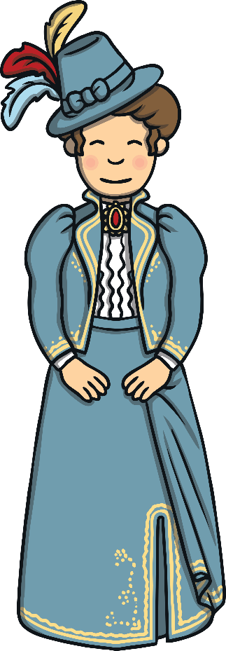
Clothing Changes
Fashion in the 1900s has changed a lot.
At the beginning of the 20th century, people covered up their bodies. Most people tended to dress the same, unlike today.
Over the century, styles changed and there were trends for each decade.
Do you know how many years there are in a decade?
There are 10 years in a decade.

Slide 3
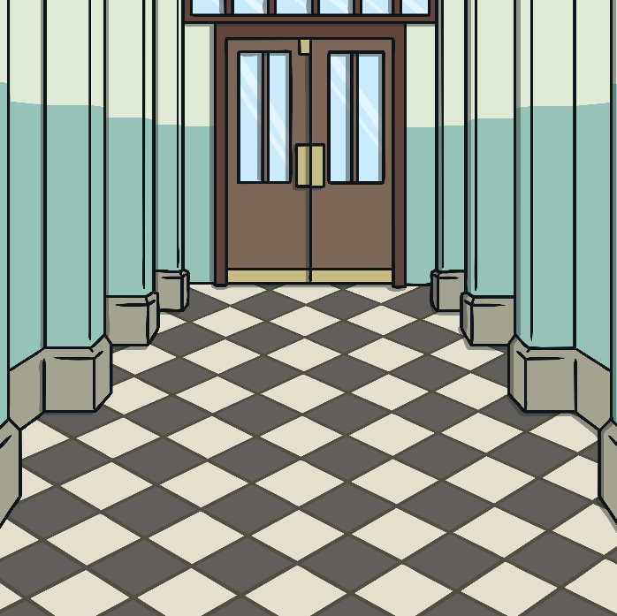
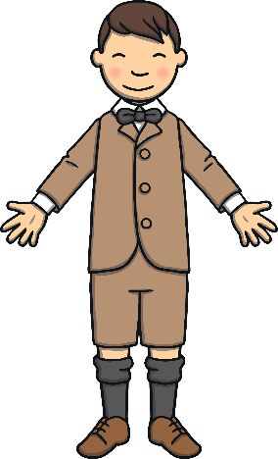
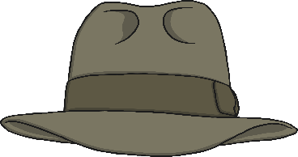
Clothing in the Early 1900s
Men and Boys
Women and Girls
Jackets and coats were often kept on by
men and boys.
They even kept them on in hot weather.
Do you have to keep your jackets on
at school?
Clothing was very different from what it
is now.
Women and girls never wore trousers.
Is this the same in your class?
Women’s legs were kept covered with long
skirts and dresses.
Interesting Fact: People usually wore hats
when they were outside, whatever the weather.

Slide 4
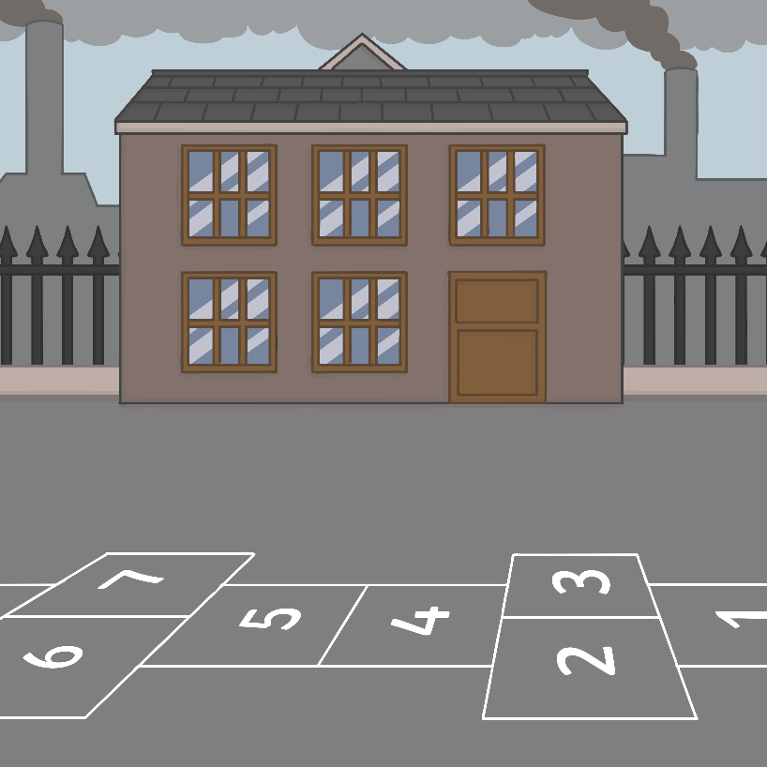
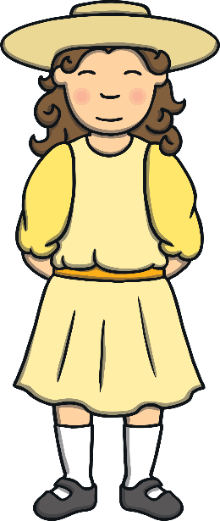
Girls Clothes
Girls wore a knee length dress or a blouse with a high collar with a knee length skirt. They had socks with either sandals, shoes or ankle boots.
Their clothes were often light in colour.
They were decorated with lace and bows.
Their hair was often worn in plaits or in curls with ribbons.
For outside, they wore knee length
coats or capes.
Interesting Fact: Girls were expected to keep themselves and their clothes clean. They were not to do things where they got dirty.

Slide 5
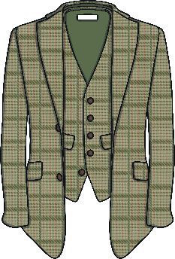
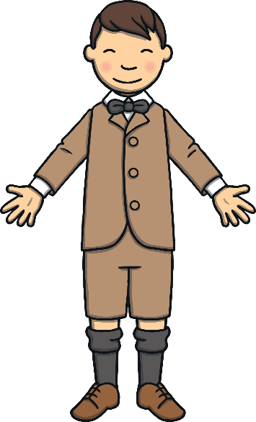
Boys Clothes
Boys wore short jackets. A popular choice was the ‘Norfolk Jacket’ which was made of tweed and had lots of pockets.
Under their jackets, boys wore waistcoats to keep warm.
Older boys often dressed like their
fathers.
Younger boys wore petticoats or
dresses like their sisters.
Interesting Fact: Younger boys from richer families often wore navy blue sailor suits.

Slide 6
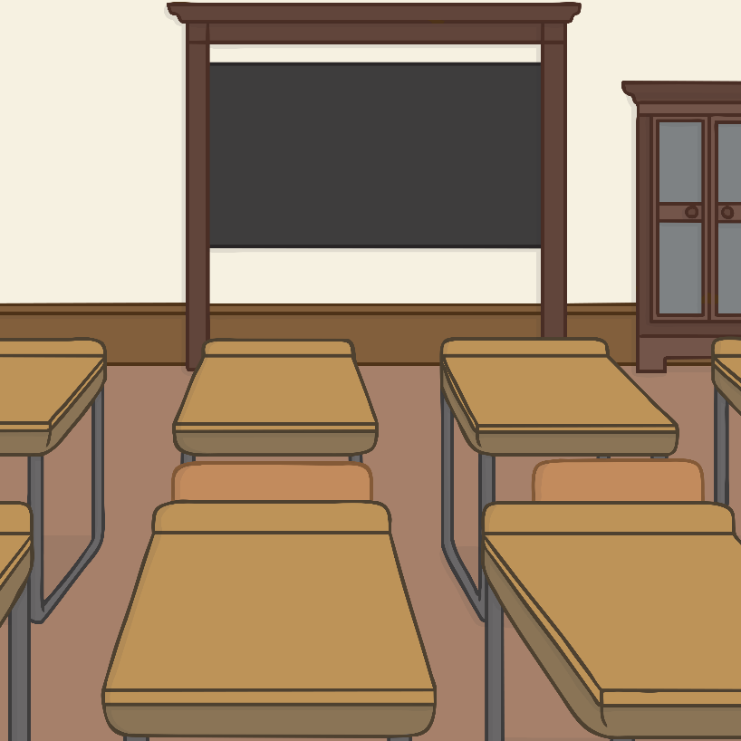
School Uniform
Poorer families sent their children to ‘board schools’. Here, they didn’t wear uniforms. It wasn’t until around 1920 that children wore uniform at ‘board schools’.
For the richer children who attended other schools, girls wore straw boaters.
Girls wore their hair in a bun or tied back with a ribbon. The bows made out of the ribbons were enormous.
Boys had their hair cut short, especially around the ears.
They wore jackets or waistcoats with trousers. They also had detachable collars which folded flat.

Slide 7
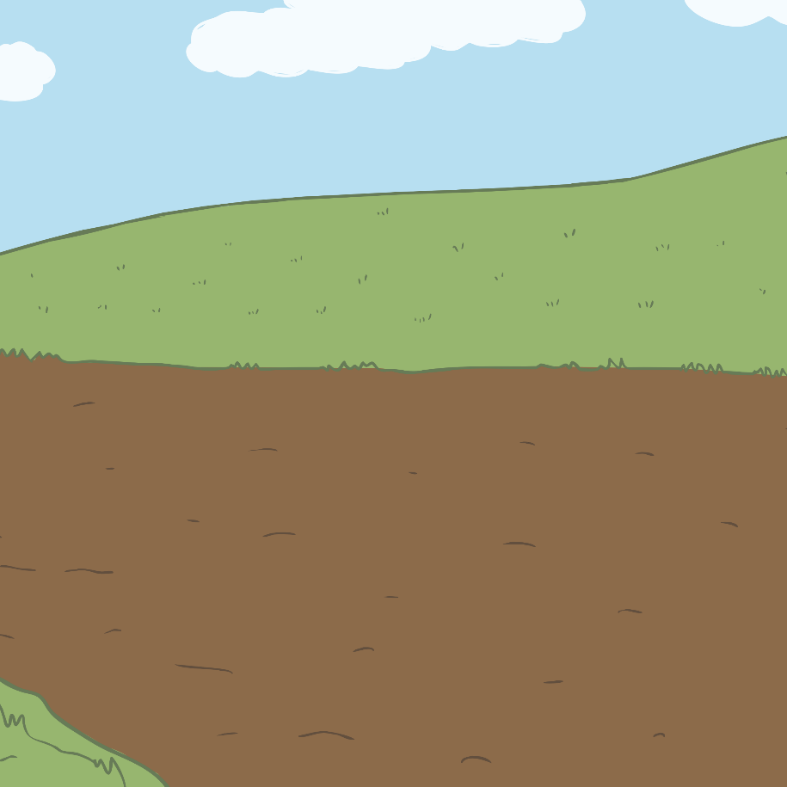
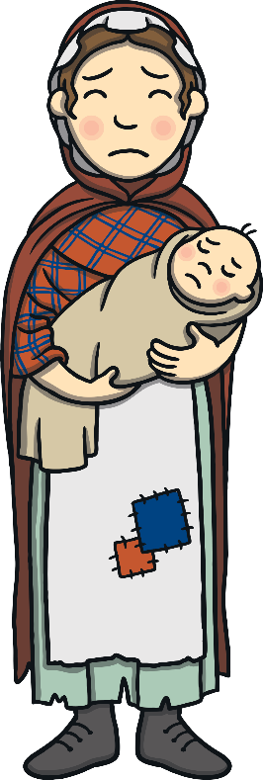
Women’s Clothes
Richer Families
Poorer Families
Women wore a white blouse with an ankle length skirt. They wore aprons around their waist and possibly a shawl that they had made themselves out of wool.
They wore hats, even indoors when visiting somebody or attending church.
Women wore ankle length dresses or skirts. Their dresses either had long, puffy sleeves or sleeves ending at the elbow. Dark skirts were worn with long sleeved white blouses.
Their shoes were flat. High heels only began to be worn after the First World War.
Hats were very popular. They would often be decorated with feathers, fruit and flowers.

Slide 8
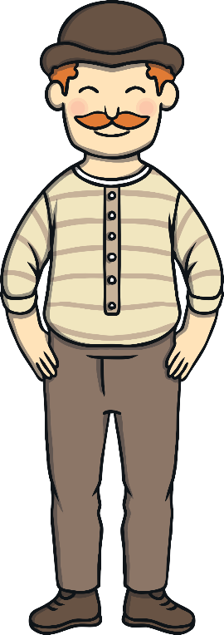
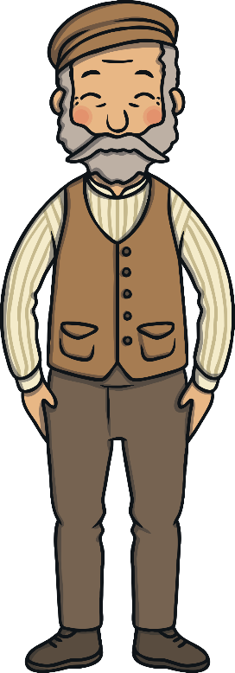
Men’s Clothes
Richer Families
Poorer Families
Men wore short jackets, shirts without collars and waistcoats.
They wore flat caps and did not wear their hats indoors. When they went to church, they took their hats off as a mark of respect.
Men always wore a suit with a jacket. Their jackets were usually black or dark grey and went to their knees. Their shirts had a wing collar which stood stiffly around the neck. Underneath their jackets, they wore a waistcoat in which they kept a pocket watch.
Hats were worn when outside and walking sticks were carried. Top hats were worn for important occasions.

Slide 9
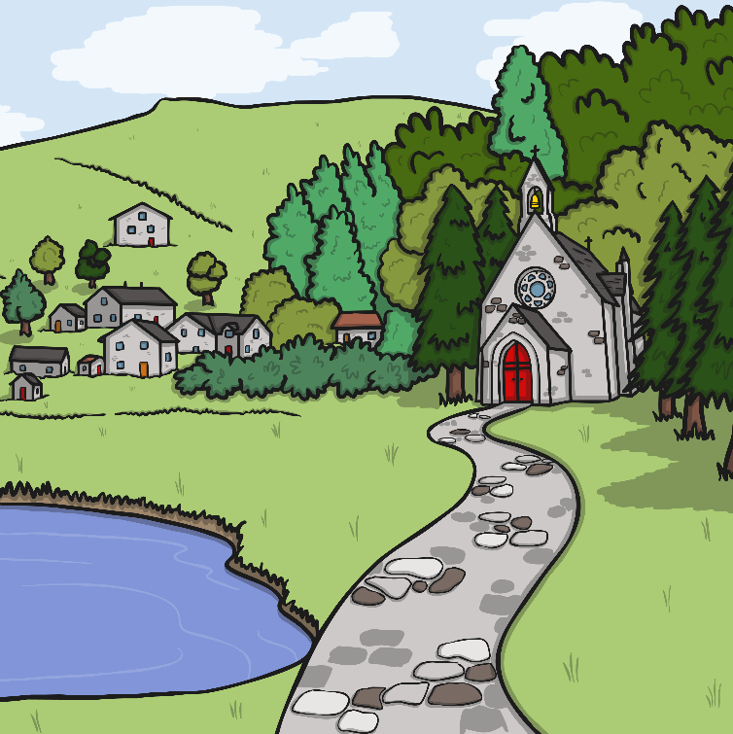
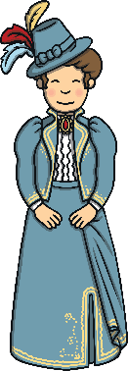
Church Clothes
Everybody wore their best clothes on a Sunday for church. They were known as their ‘Sunday best’. Some people who had more money had a special dress or suit that they only wore on a Sunday.

Slide 10
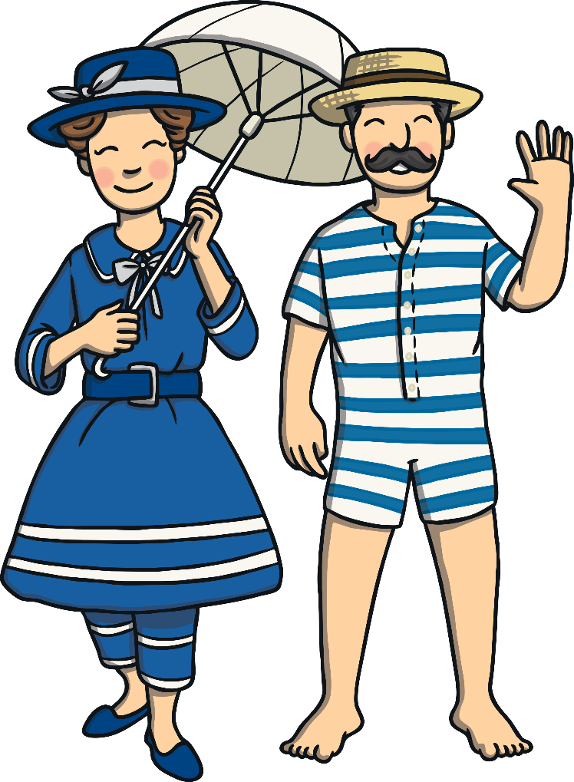
Swimwear
Men’s swimwear was usually a one piece, down to their knees with their shoulders covered.
Gradually over the years, swimwear has got smaller and less of the body has been covered.
Unlike today, beaches were places where people still kept their bodies covered.
In the early 1900s, women’s swimsuits looked like a dress worn over baggy trousers (bloomers). These suits were heavy and made
it difficult to swim.

