Slide 2
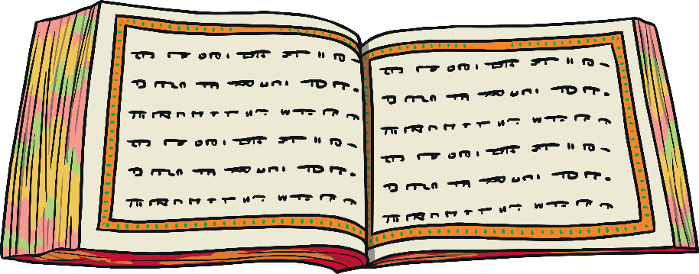
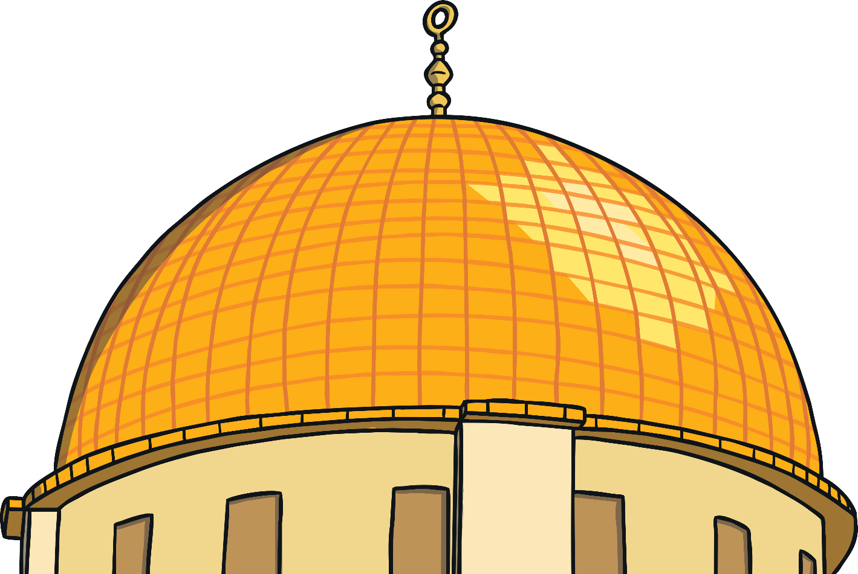
Starter Activity
What is the Qur’an?
What do you already know about it?

Slide 3
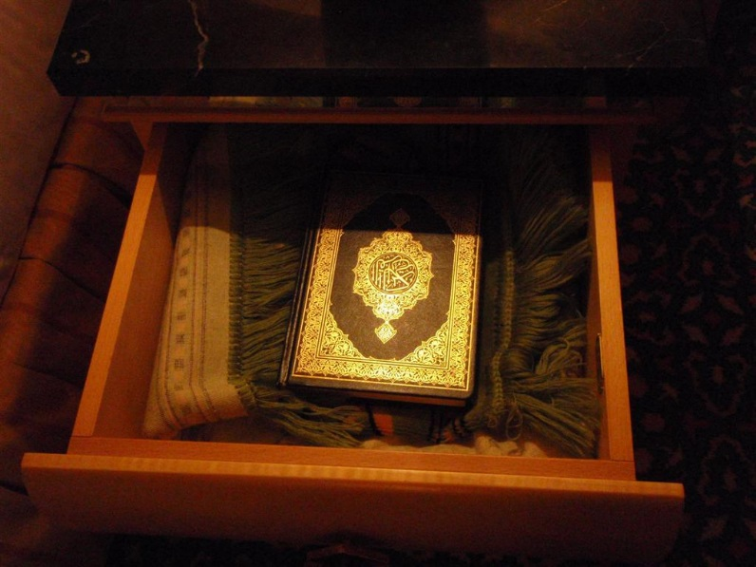
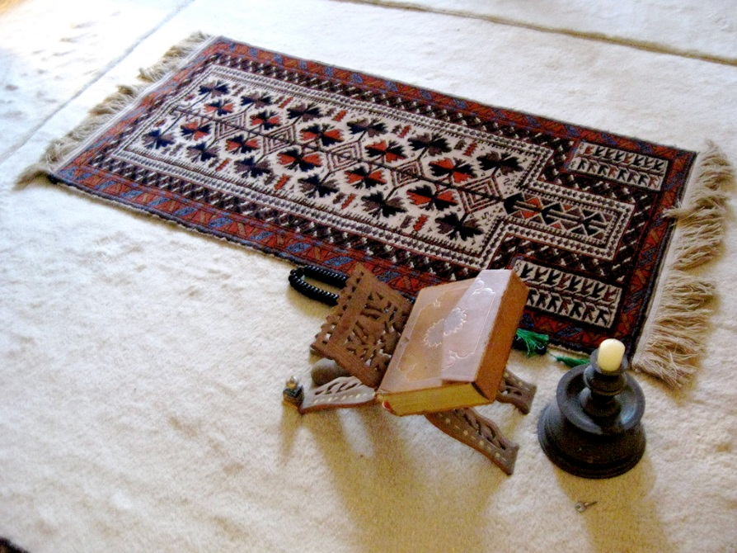
What is the Qur’an?
The Qur’an is the holy book for Muslims and is written in Arabic.
Muslims believe it is the perfect word of God.

Slide 4
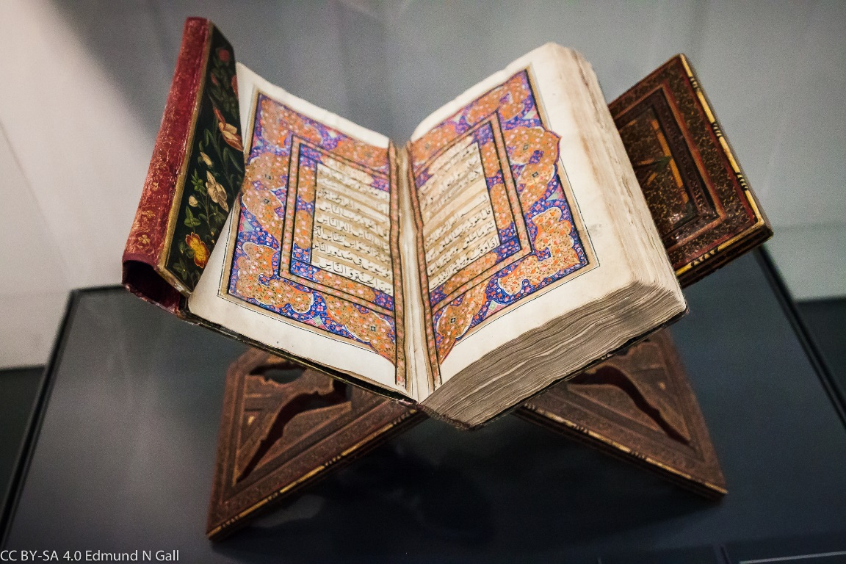
What is the Qur’an?
Muslims show respect for the Qur’an by washing their hands before touching it. When not being used, the Qur’an is often wrapped up in a special cloth and kept on a high shelf to show respect.
It must never touch the floor and is placed on a special stand when being read. Many Muslims around the world learn the Qur’an off by heart!

Slide 5
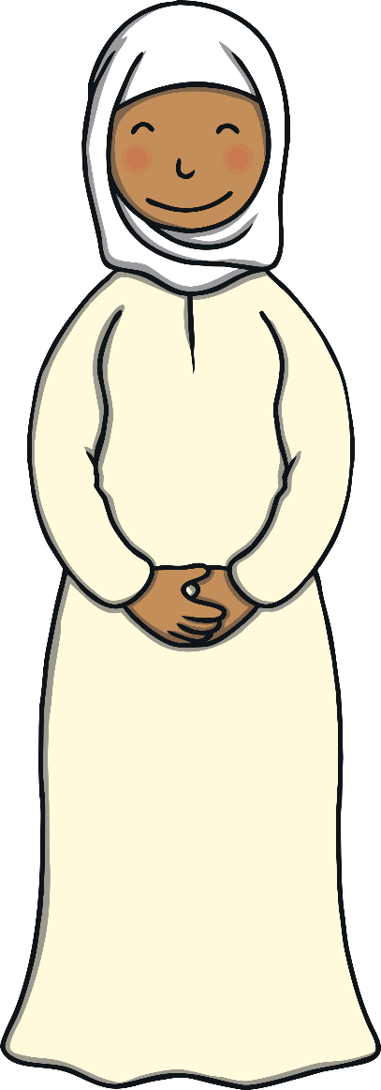
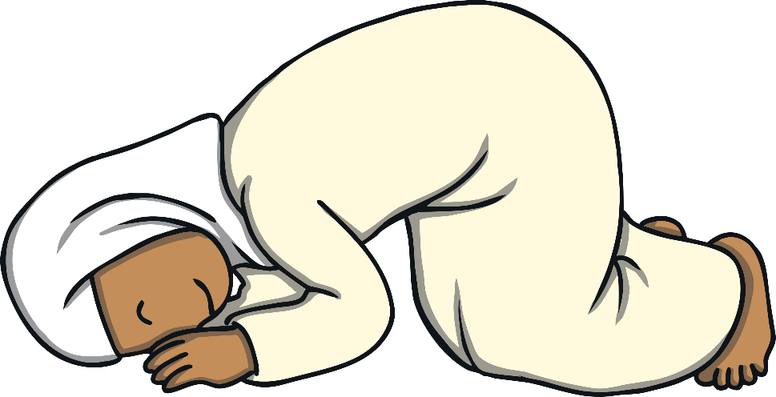
The Qur’an Activity
Watch the video to find out more about how children learn how to read the Qur’an.
BBC Bitesize

Slide 6
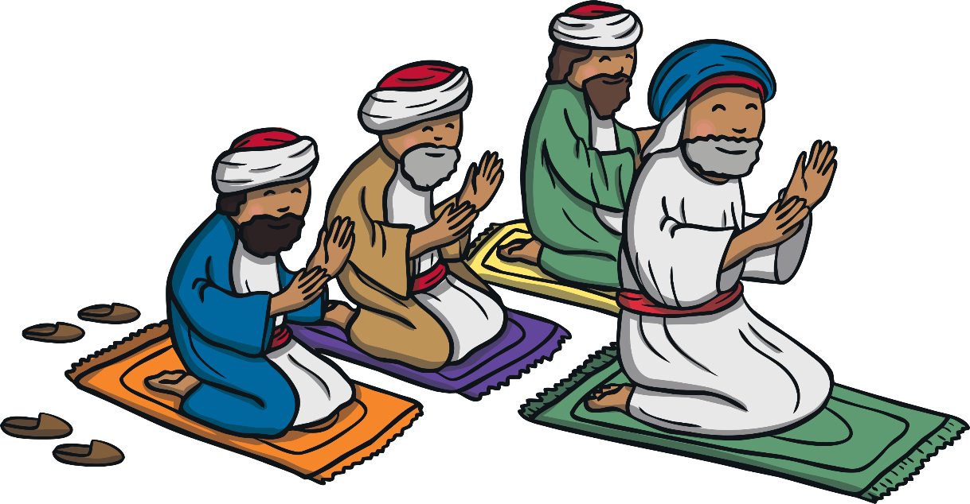
The Qur’an
The Qur’an teaches Muslims how to live a good life.
Here are just a few rules which Muslims must live by:
Worship only one God
Pray 5 times a day
Give to charity
Show respect and love to your parents
Show forgiveness to others

Slide 7
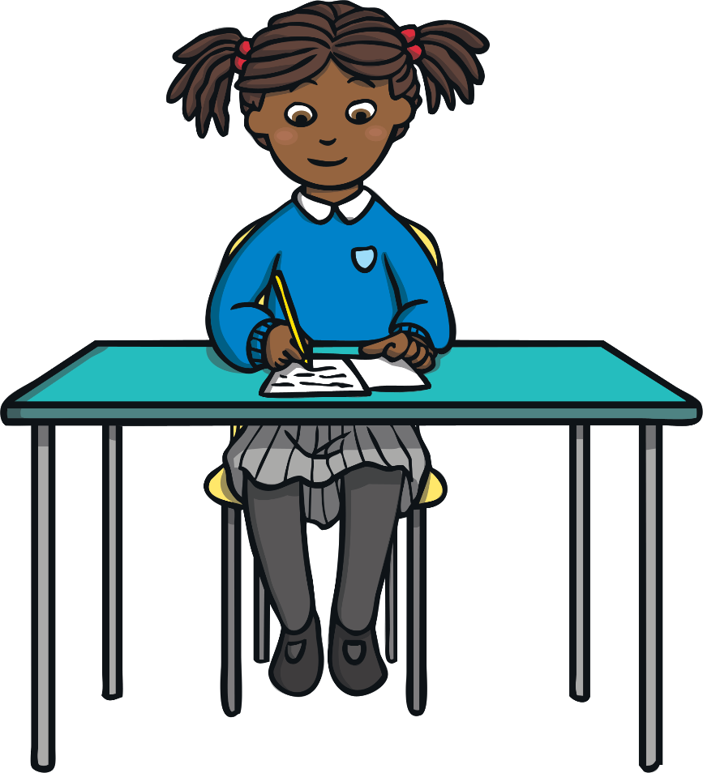
Your Task
Write your own set of rules which
would help to make the world a better place.

